Slide 1
JNCIS-ENT
Layer 2 switching and VLANs

Slide 2
Frame Processing
6
Switched frame and packet processing

Slide 3
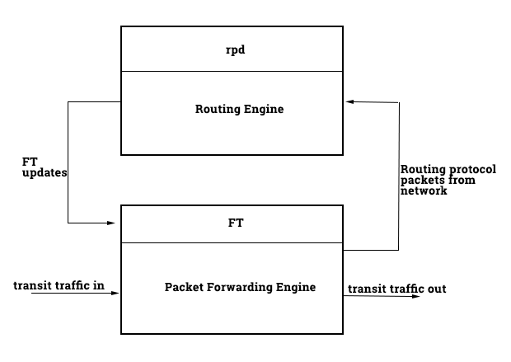
Control and Forwarding Planes
Like other Junos devices, the EX-series switches feature a distinct control plane (RE) and forwarding plane (PFE).
/ BT

Slide 4
Control and Forwarding Planes
Internal link between RE and PFE is rate limited, it is hard-coded and not able to be modified. PFE updates are a high priority in the kernel and are done incrementally.
/ BT

Slide 5
Frame Processing – Unknown Source
1
Frame enters ingress port
2
Ingress PFE performs MAC lookup, determined source is unknown.
3
Ingress PFE sends header information to RE where MAC is added or discarded
4
If new MAC added to bridge table, new entry is sent to all PFEs
Notes:
MAC may be discarded if port-security / mac limiting is enabled.

Slide 6
Frame Processing – Known Destination
1
Frame enters ingress port
2
Ingress PFE performs MAC lookup, determines egress PFE and port
3
Ingress PFE forwards frame to egress PFE
4
Egress PFE forwards frame out egress port.
Notes:
No additional lookup is done by PFE n.

Slide 7
Frame Processing – Unk. Destination
1
Frame enters ingress port
2
Ingress PFE performs MAC lookup, determines unknown destination and must flood frame
Ingress PFE and all remote PFEs flood frame out all ports in broadcast domain
3
Notes:
No additional lookup is done by PFE n.

